Slide 1

Troll Detection, Categorization and Statistical Analysis
By: Badar, Keshav and Bibekjyoti

Slide 2

INTRODUCTION
Now a day’s social media plays very crucial role in formation of public opinion and Social influence.
Public opinion is sometimes driven by rumours, fake allegations. This fake, aggressive comments on social media are known as Trolls/
The project is devoted to study the trolling behaviour of people on Twitter.
The study was conducted on live data gathered from twitter based on various categories like politics, sports personalities, Govt Institutions etc.
The Scope of the project is to classify the tweets gathered into trolls and non trolls using NLP and other machine learning tools.

Slide 3






Project analysis slide 2
PROJECT LIFE CYCLE
TESTING
DATA GATHERING
PROJECT
ANALYSIS & VISUALIZATION
DATA PREPARATION
MODEL TRANINING
DATA WRANGLING

Slide 4
Project analysis slide 4
PROJECT FLOW
To Classify tweets into Troll and Not-Troll
Project Objective
Visualization of
the tweets and
basic analysis
Visualization and Analysis
Statistical analysis of to find insight on the tweets and their relationship
DATA GATHERING
Text Preprocessing
Classification of tweets
Data Gathering
Model Creation
Statistical Analysis
Tweets gathered from twitter was classified on the base of the trained model
Data extracted from Twitter using Twitter API and stored in MongoDB
Tweets were cleaned using NLP Pre-processing steps
Model was created trained and tested with labeled data
Validating the model to see the accuracy from the survey of the subset tweets
Validation of the Model

Slide 5

DATA EXTRACTION
You need to have Twitter Developer account to gather the data from twitter.
Below details are needed to fetch the data from Twitter
Consumer Key
Consumer Secret Key
Access Token
Access Secret
The tweets were captured from different sectors/categories like politics, sports, celebrity, etc.
For extraction, Tweepy library was used to gather the data from Twitter using Python
Data retrieved from Twitter were stored in MongoDB database
Dataset with already labeled tweets as Troll and Not-Troll were downloaded from the internet for model training

Slide 6
DATA PREPARATION & WRANGLING
The tweets extracted are in JSON format
Selection of the required field were extracted and stored in a new collection inside MongoDB
The tweets and the training data had to be processed before passing it to the model
Working with textual data is called as NLP (Natural Language Processing).
Steps used to pre-process the data:
Removing hashtags, mentions, URLs, emoji, smiley and numbers from the text
Converting text to lower case
Abbreviating the short words like what’s, LOL, etc.
Removing punctuations
Removing stop words like a, the, etc.
Lemmatization of the words

Slide 7
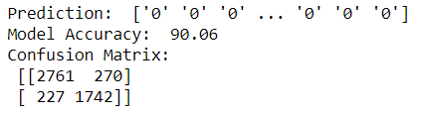
MODEL TRAINING & TESTING
The labeled data was used to train and test the model after applying all the preprocessing steps.
The text was split into model training and testing data
The data was vectorized for feature extraction and training of the model.
We used custom bagging for training the model which includes the below algorithms:
MultinomialNB
DecisionTreeClassifier
RandomForestClassifier
SVC
PassiveAggressiveClassifier
Voting Classifier was used to get the best vote for each tweet from the above algorithms to classify it into Troll or Not-Troll
Model Accuracy was ranging between 88 – 90.9 percentage

Slide 8
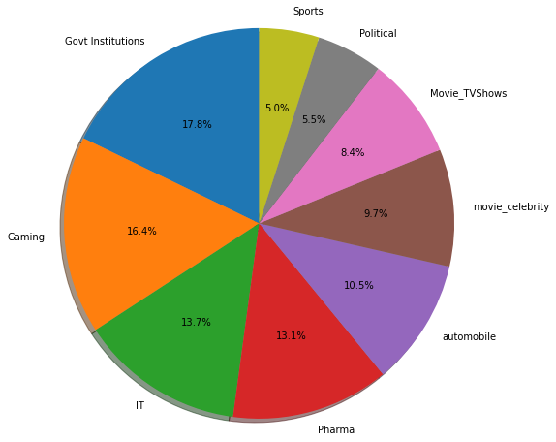
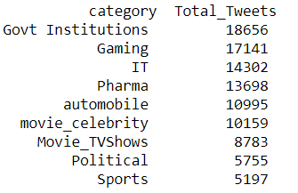
TOTAL TWEETS PER CATEGORY
Checking of total tweets per category
Visualizing the total tweets per category using Pie Chart

Slide 9
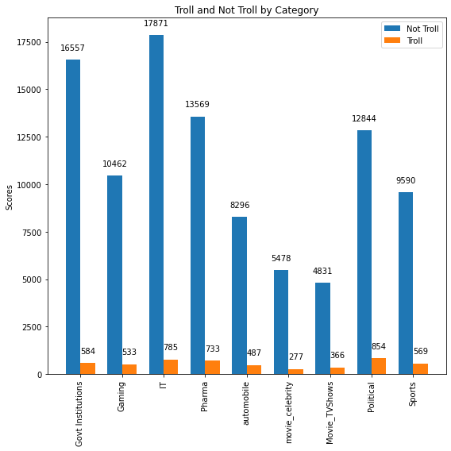
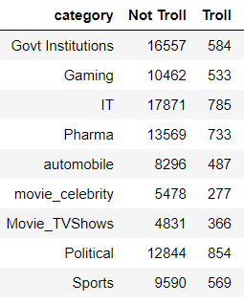
CATEGORY WISE EXTRACTED DATA
Extracted tweets were passed to the trained model for classification
Classified tweets were checked on the basis of categories and a bar chart was plotted for visualization

Slide 10
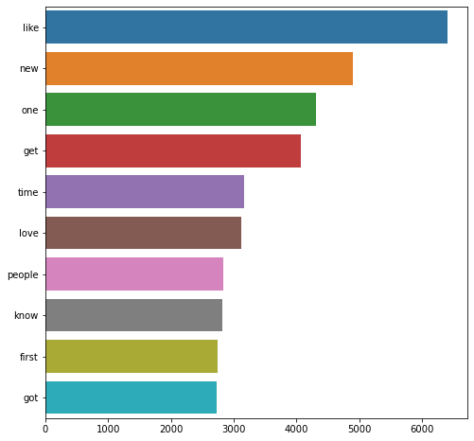
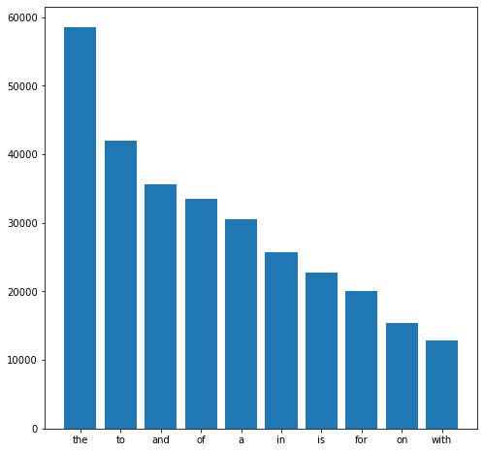
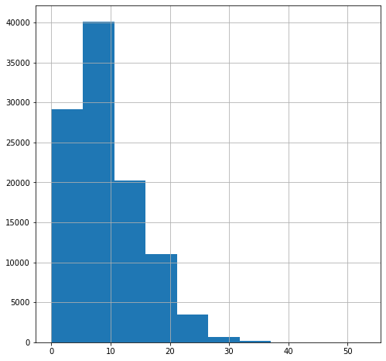
FREQUENTLY OCCURING WORDS
We wanted to know the frequently used words in tweets and plotted a bar chart of top 10 words
We also checked the most frequent occurring stop words in the tweets and plotted a bar chart
Frequency distribution of total word count in tweets which was done using histogram
Frequently Used Words
Frequent Used Stop words
Distribution of Total Word Count

Slide 11
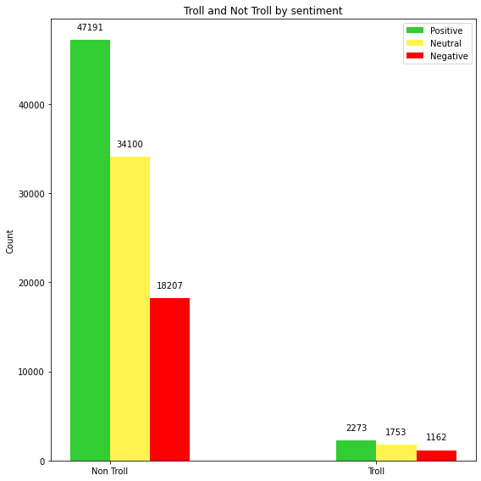
TROLLING Vs SENTIMENT
Distribution of sentiments over troll and non-troll tweets

Slide 12
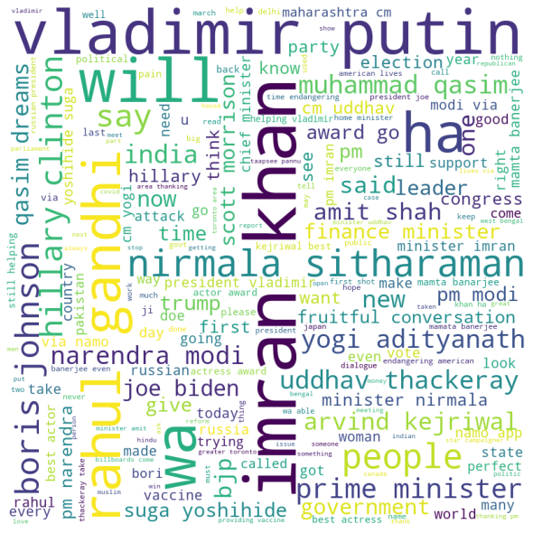
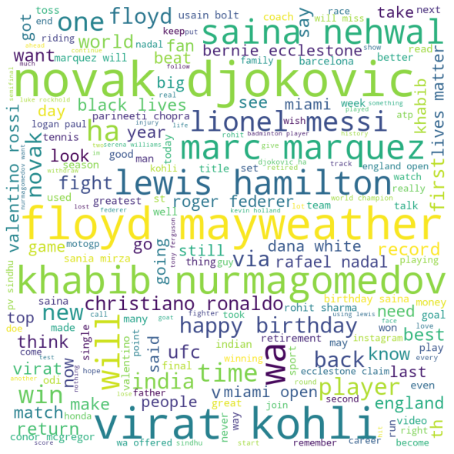
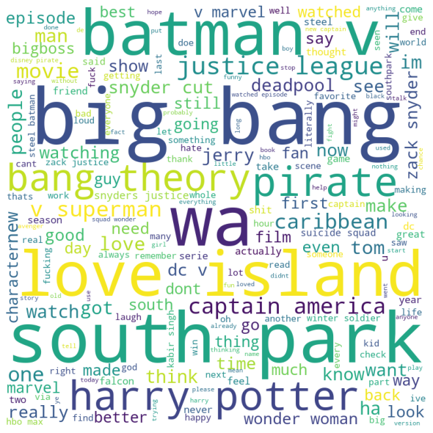
CATEGORY WISE WORDCLOUD
POLITICS
SPORT
MOVIES & TV SHOWS

Slide 13
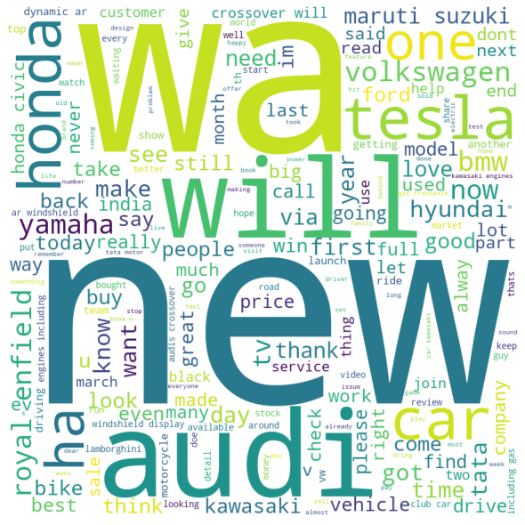
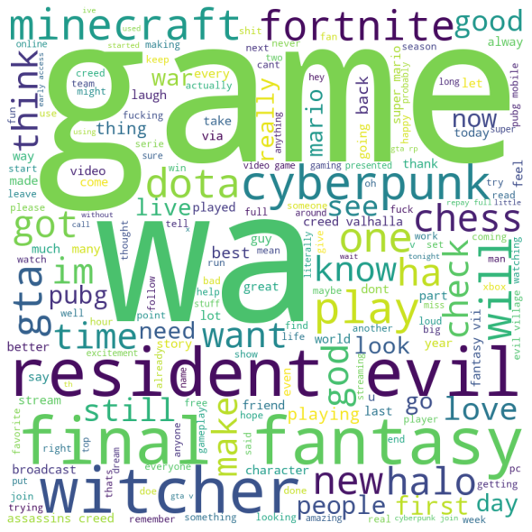
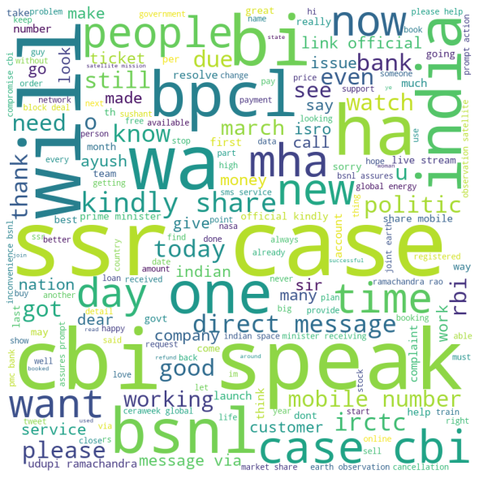
CATEGORY WISE WORDCLOUD
AUTOMOBILE
GAME
GOVERNMENT INSTITUTIONS

Slide 14
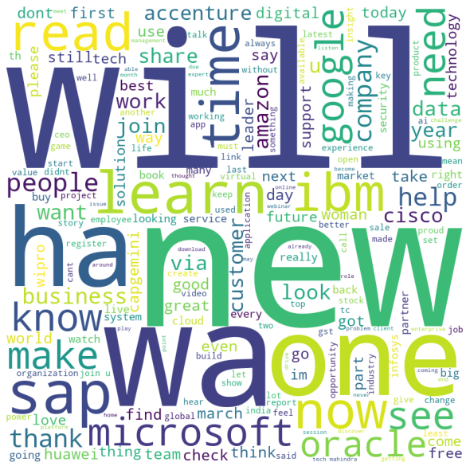
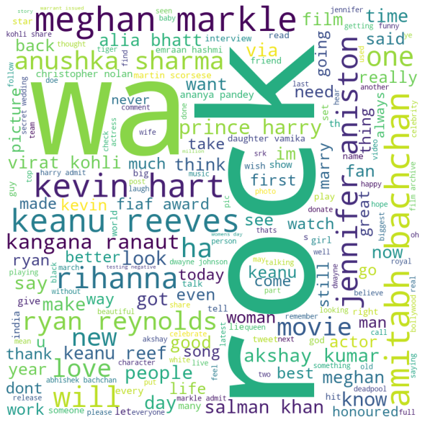
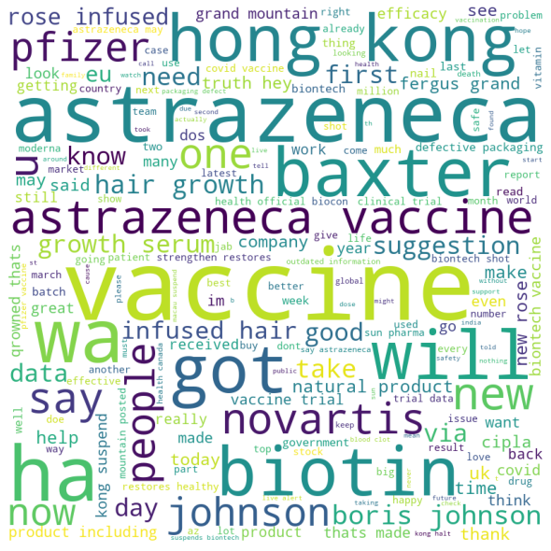
CATEGORY WISE WORDCLOUD
IT
MOVIE CELEBRITY
PHARMACEUTICAL INDUSTRY

Slide 15
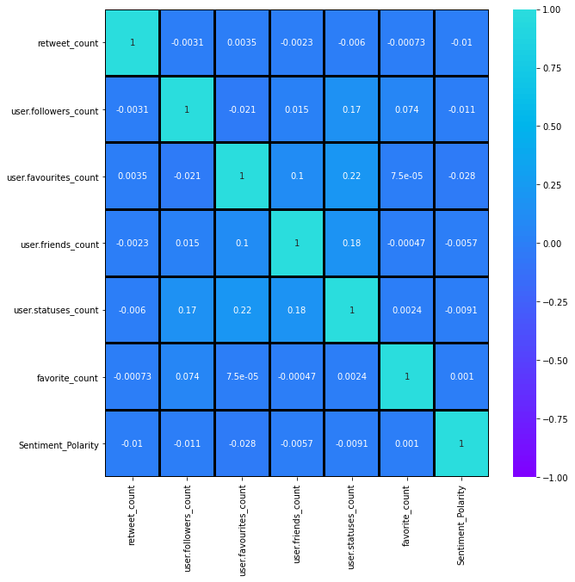
RELATIONSHIP BETWEEN SENTIMENT POLARITY & OTHERS
From correlation matrix we can say that there is weak correlation between the variables.

Slide 16
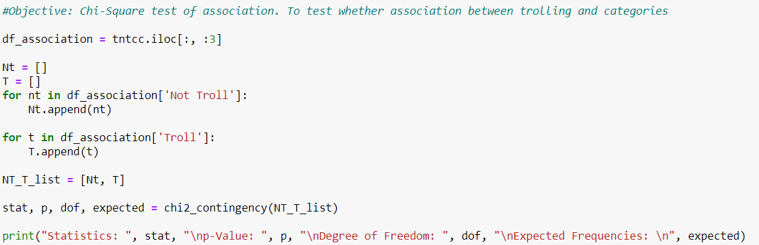
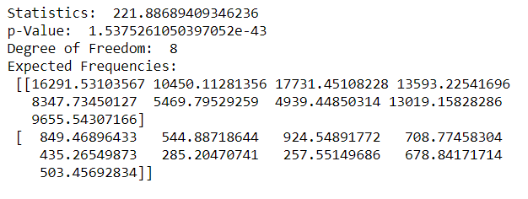
CHI SQUARE TEST OF ASSOCIATION
To test the association between Sectors and Trolling
The hypotheses are:
H0: There is no association between Sector and tweet type. Vs
H1: There is significant association between sectors and tweet type.
p-value for test of association is less than 0.05. Thus, H0 is rejected.
It may conclude that there exists significant association between sectors and tweet type (Troll/ Not Troll).

Slide 17
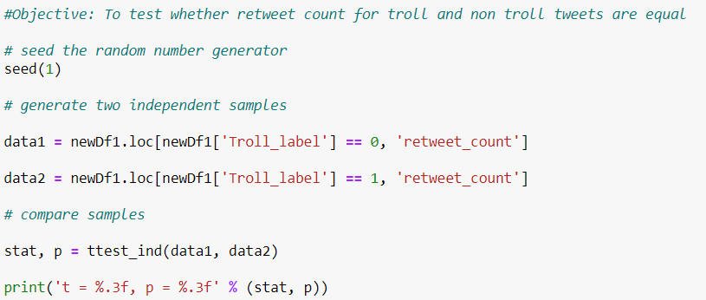
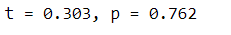
T TEST FOR EQUALITY OF TWO POPULATION MEANS
To test whether average retweet count for Troll and Not troll tweets is different.
Test hypotheses are,
H0: The average retweet count for troll and non-troll tweets are equal. Vs
H1: The average retweet count for troll and non-troll tweets are not equal.
Since P-value is greater than 0.05. Thus, at 5% level of significance,
it may be concluded that the average retweet count for troll and non-troll tweets is equal.

Slide 18
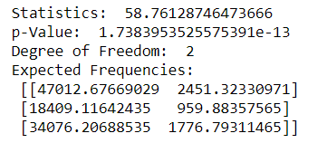
CHI SQUARE TEST OF ASSOCIATION
To test whether Trolling depends on sentiment category.
H0: There is no association between tweet type and sentiment category
H1: There is association between tweet type and sentiment category
Sentiment Polarity gives idea about whether the tweet is Positive negative or neutral.
p-value for test of independence is less than 0.05. Thus, H0 is rejected.
It may conclude that there exists significant association between sentiment category and tweet type (Troll/ Not Troll).

Slide 19
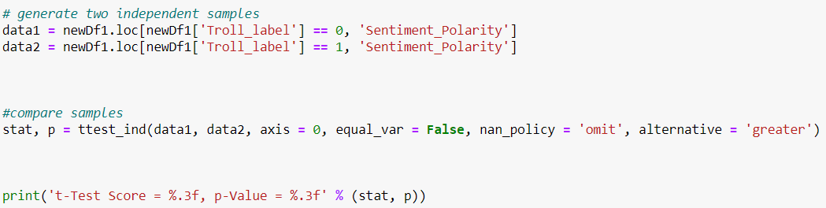
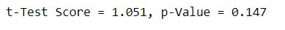
T TEST FOR EQUALITY OF SENTIMENT POLARITY
To test whether trolls have negative sentiment than non-troll tweets following test is performed.
H0: The average sentiment polarity for trolls and non-trolls is equal. Vs
H1: The average sentiment polarity of trolls is less than that of non-trolls.
P value is greater than 0.05. Thus, accept H0 at 5% level of significance.
It may be concluded that the average sentiment for troll and non-troll is equal.

Slide 20
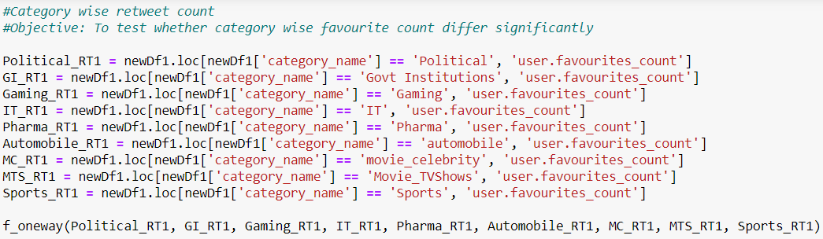
ONE-WAY ANOVA
To test whether sector wise user favourite count differ significantly.
H0: There is no significant difference among the sectors.
H1: There is significant difference among the sectors.
P value is less than 0.05. Thus, H0 is rejected at 5% level of significance.
It may be concluded that the sector wise user favourite count differs significantly.

Slide 21
ONE-WAY ANOVA
To test whether sector wise user follower count differ significantly.
H0: There is no significant difference among the sectors in terms of follower count.
H1: There is significant difference among the sectors in terms of follower count.
P value is less than 0.05. Thus, H0 is rejected at 5% level of significance. It may be concluded that the sector wise user favourite count differs significantly.

Slide 22
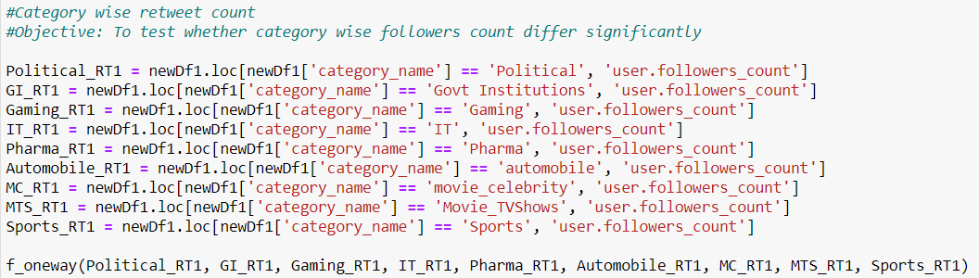
ONE-WAY ANOVA
To test whether sector wise user follower count differ significantly.
H0: There is no significant difference among the sectors in terms of follower count.
H1: There is significant difference among the sectors in terms of follower count.
P value is less than 0.05. Thus, H0 is rejected at 5% level of significance. It may be concluded that the sector wise user follower count differs significantly.

Slide 23
ONE-WAY ANOVA
To test whether sector wise retweet count for tweet differ significantly.
H0: There is no significant difference among the sectors in terms of retweet count.
H1: There is significant difference among the sectors in terms of retweet count.
P value is less than 0.05. Thus, H0 is rejected at 5% level of significance. It may be concluded that the sector wise retweet count for tweet differs significantly.

Slide 24
CONCLUSION
Trolling is independent of sentiment, trolling can have positive sentiment
There is no relationship between sentiment polarity and user profile like user follower count, user favorite count
It is found that sector wise trolling is significant
The average retweets of Troll and Non-Troll are equal. It implies that retweeting has nothing to do with tweet type
The average sentiment polarity for Troll and Non-Troll are equal. Though, there exist a significant association between sentiment category and tweet type
There is no difference among the sectors in terms of user favorite count, follower count, retweet count

Slide 25
FUTURE SCOPE
We can further categorize Trolls into obscene trolls, hateful trolls, thirst trolls, etc.
Utilization of sentiment polarity along with labeled data for better classification

Slide 26
THANK YOU

